Slide 1
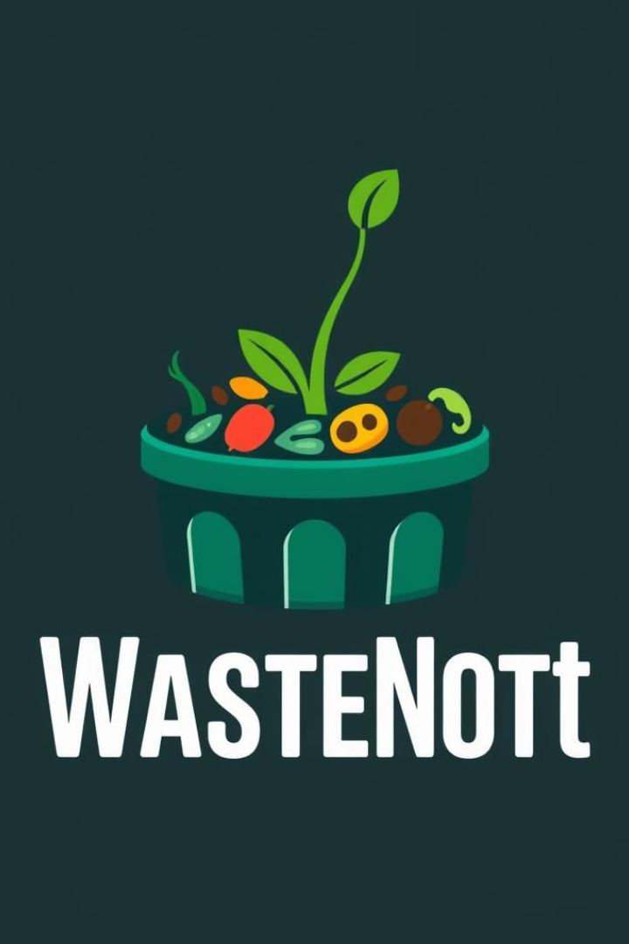
WasteNot – Food Waste Management App

Slide 2
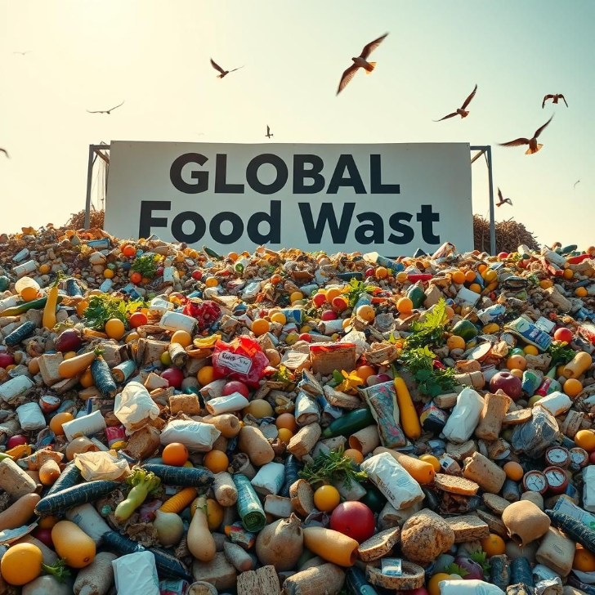
Problem: Global Food Waste
Massive Food Waste
Globally, 1.3 billion tons of food is wasted yearly. Millions suffer from hunger.
Inefficient Disposal
Restaurants and homes discard surplus food. This happens due to absent real-time donation networks.
Lack of Centralization
There is no centralized system. It could efficiently connect food donors with recipients.

Slide 3
WasteNot: The Solution
Real-time Coordination
Key Features
A mobile & web app enabling real-time food donation & pickup coordination.
Food Donation Matching
Real-time Food Listings
Location-Based Matching
Pickup Coordination
Dashboard & Analytics
AI-based Food Quality Check (Optional)

Slide 4
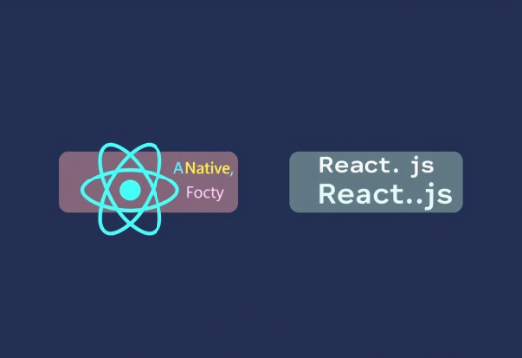


Technology Stack Overview
Frontend (App/Web)
Backend
Database
React Native / Flutter (Mobile) OR React.js (Web)
Node.js + Express / Django + FastAPI
Firebase / MongoDB
Additional technologies used are Google Auth, Firebase Auth, Google Maps API, and TensorFlow.js (optional AI feature).

Slide 5
HOW IT WORKS?
Donor logs food details
AI matches recipients
Pickup & Delivery
Impact Tracking

Slide 6
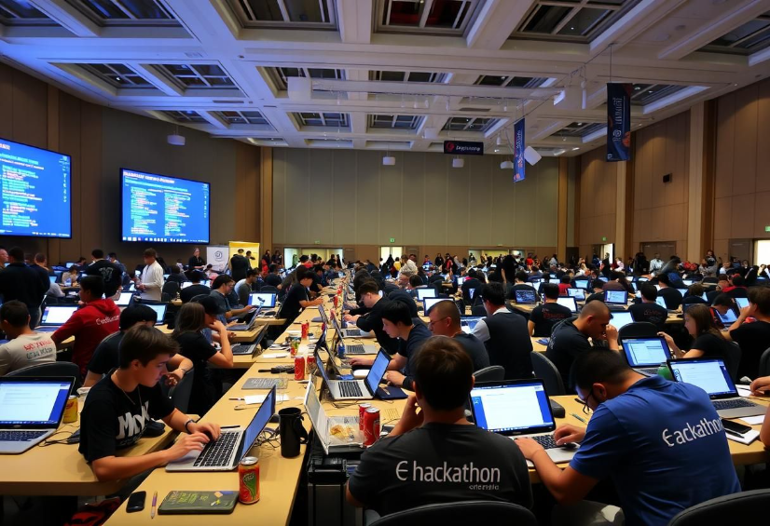
BUSINESS MODEL
💰 Freemium Model
🚚 Logistics Partnership
🎯 CSR Partnerships
📈 Subscription-Based Revenue

Slide 7
Market Opportunity
🌍 $1 Trillion Food Waste
👥 Target: Restaurants, Grocery Stores, NGOs
📊 Growing Demand

Slide 8
Competitive Advantage
✔️ AI-Powered Matching
✔️ Seamless Logistics
✔️ Impact Measurement
✔️ User-Friendly Interface

Slide 9
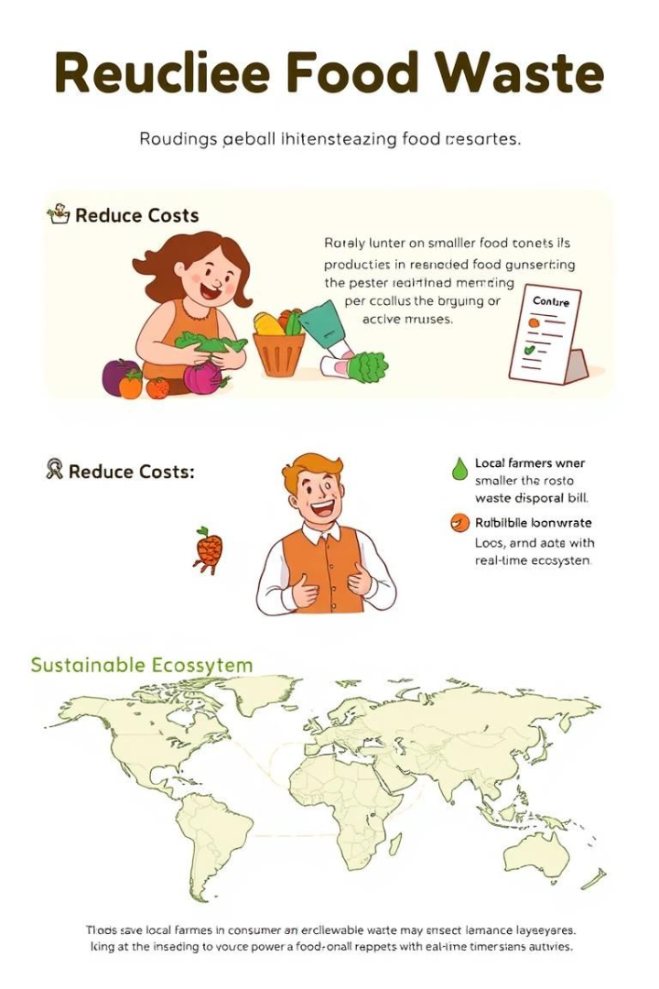



Potential Impact
Reduce Waste
Reduce global food waste & hunger by streamlining food donations.
Reduce Costs
Help restaurants, businesses, and households reduce waste disposal costs.
Sustainable Ecosystem
Encourage a sustainable food ecosystem with real-time impact tracking.

Slide 10
Social & Environmental Impact
🌿 Reducing Food Waste
🥗 Feeding the Hungry
♻️ Sustainable Solution

Slide 11
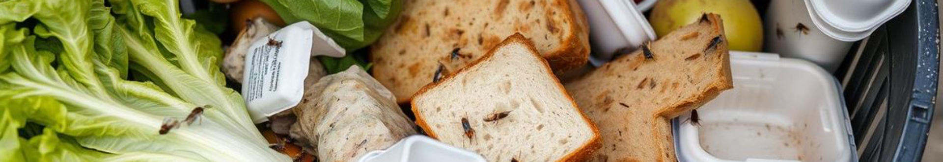



Future Enhancements
AI Freshness Checker
Image analysis for food quality verification.
Blockchain Ledger
Transparent tracking of food donations.
Gamification
Badges & incentives for regular donors.

Slide 12
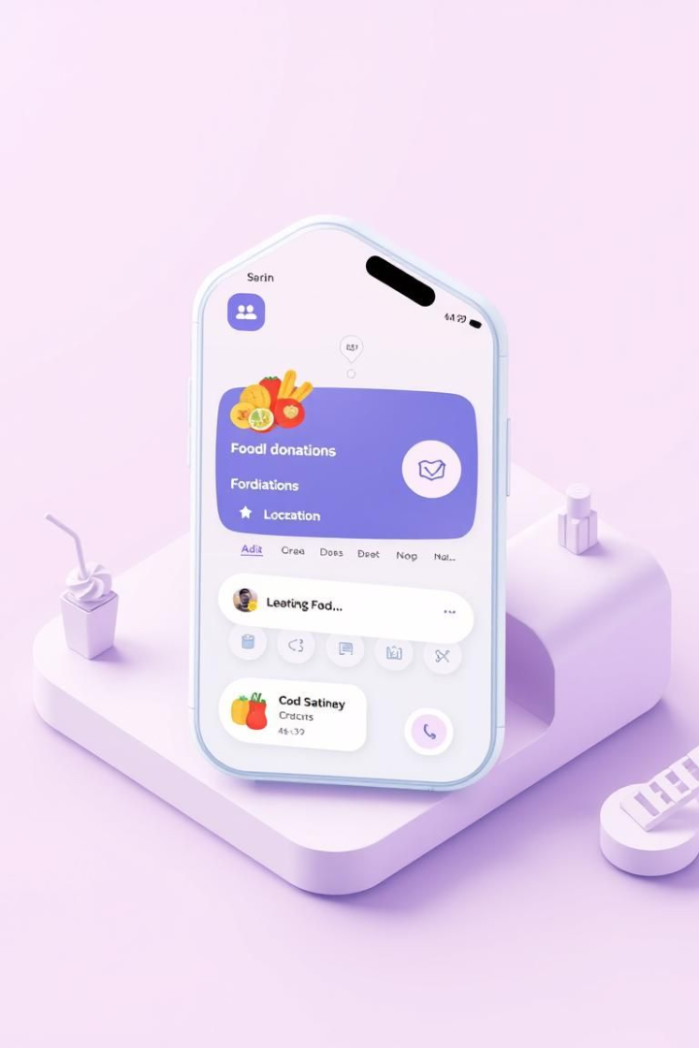
WasteNot App Overview
WasteNot is a revolutionary food waste management app.
It connects food donors with those in need, reducing waste and feeding communities.
Real-time Matching
Easy Coordination
Connects donors and recipients instantly.
Simplifies food pickup and delivery.
Impact Tracking
Monitors food waste reduction efforts.

